Slide 1

PGPDSE-FT BANGALORE APRIL21
CAPSTONE GROUP 4 INTERIM PROJECT PRESENTATION
Modeling and Predicting the Optimal First-Touch Turn Around Time for Allocation of Tickets to Employees in an E-Commerce Company
Team MEMBERS
Anvesh Raj Chitrapu
Nithin Deepak
Kumar V
Niyantri Vishnu M
Kavya Sree
Aquib Yasin
UNDER THE GUIDANCE OF:
Mrs. Vidhya K
PROJECT DOMAIN:
E-commerce

Slide 2


Objective
The company faces the problem of prioritizing the allocation of tickets to its employees, in an attempt to resolve the ‘customer returns’ and other issues before the deadline.
The tickets are assigned to its associates based on First in First out (FIFO) basis to investigate and resolve the issue.
As per the SOP, tickets are to be resolved within 12 days of Service Level Agreement (SLA).
To devise a model and predict the optimal day to allocate a ticket to an associate in order to meet the Service Level Agreement (SLA).
To carry out the segmentation and interpretation of tickets based on the types and clusters of the data available.

Slide 3
Data Understanding
The dataset has 2,06,410 records and 26 attributes.
The names of the attributes are given below:
case_id
impact
category
type
item
assigned_to_group
assigned_to_individual
status
ticket_create_date
ticket_resolved_date
building_id
Quantity
Product_id
upc
vendor_id
purchase_order_id
root_cause
t_root_cause_details
title
total_tat
rbs_tat
cat_push_tat
fc_receive_tat
fc_actionable_tat
bin_check_tat
vendor_tat

Slide 4
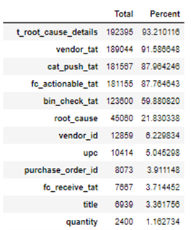
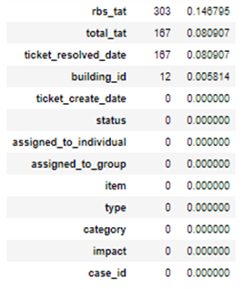
Data Cleaning
Null values were present in the data.
After analyzing the nature of the column, null values were imputed accordingly.

Slide 5
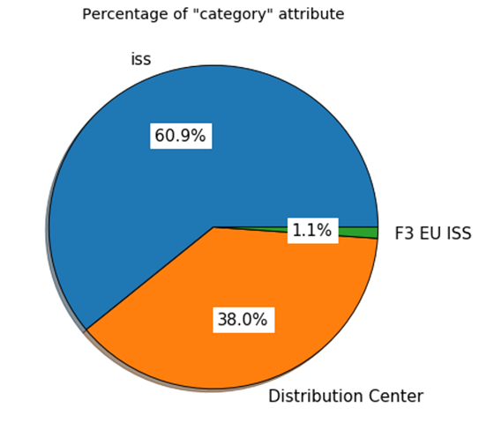
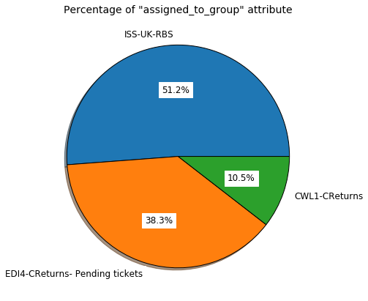
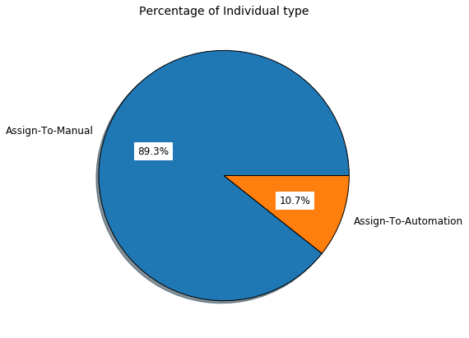
Univariate Analysis
‘category’ attribute
More than 60.9% of tickets are resolved under 'iss' category and just 1.1% of tickets are resolved under 'F3 EU ISS' category.
‘assigned_to_group’ attribute
51.2% of tickets are resolved by 'ISS-UK-RBS' team and 10.5% of tickets are resolved by 'CWL1-CReturns' team.
‘assigned_to_individual’ attribute
There are 89.3% of Manual ticket assignments. And the rest of the ticket assignments are resolved by Automation.

Slide 6
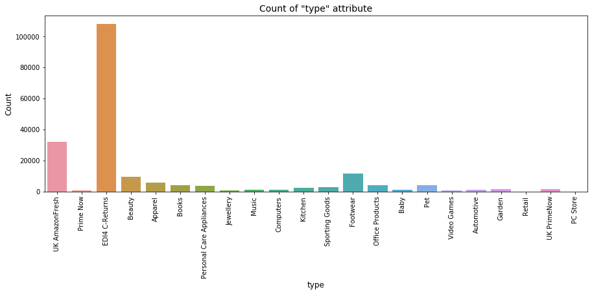
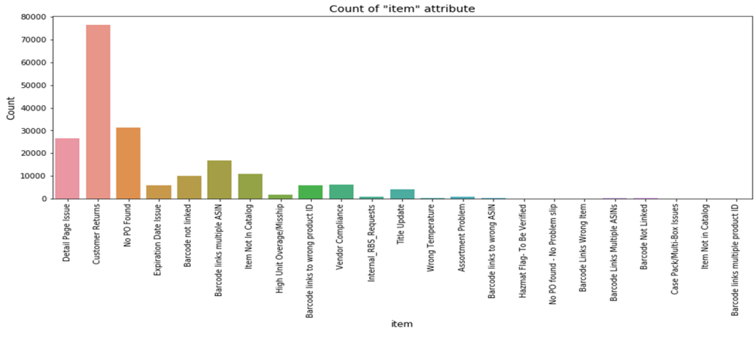
'type‘ attribute
Most of the tickets are assigned for 'EDI4 C-Returns' type of products.
‘Item’ Attribute
The 'Customer Returns' issues are maximum followed by 'No PO Found' issues.

Slide 7
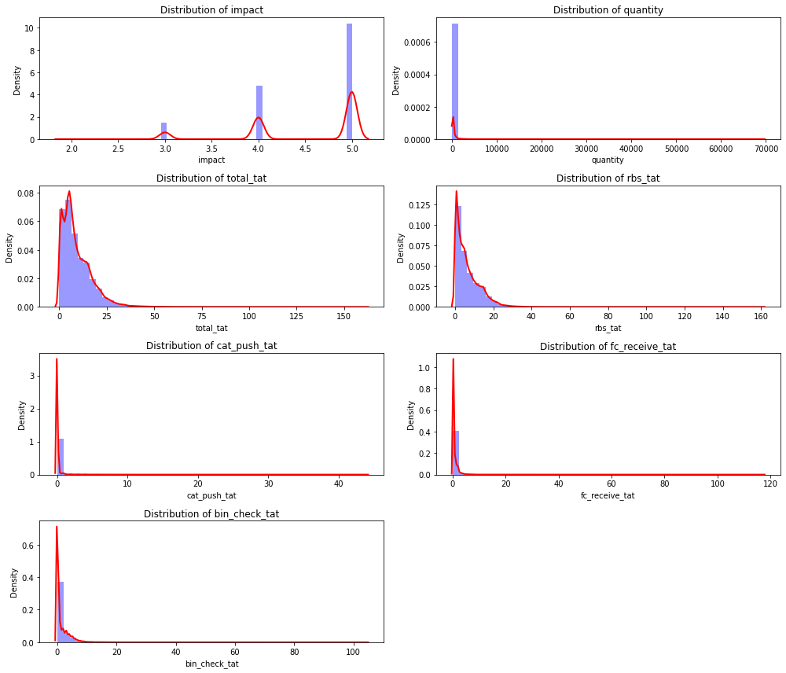
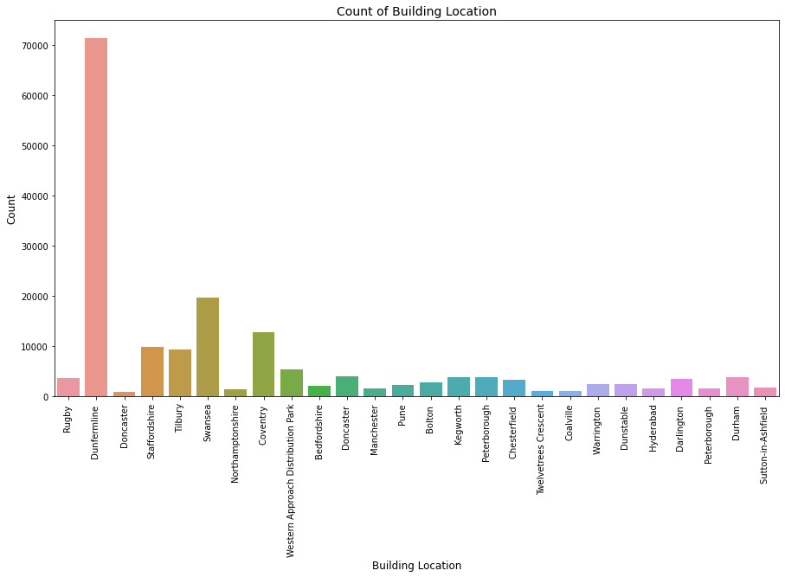
‘Building Location’
At Dunfermline location, the building_id 'EDI4' which is the only warehouse present in this location accounts for maximum number of tickets.
Distribution of numerical variables
'quantity','total_tat','rbs_tat','cat_push_tat','fc_receive_tat' and 'bin_check_tat' are positively skewed.
'impact' is negatively skewed.

Slide 8
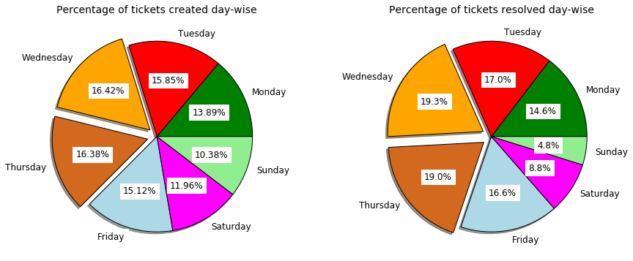
‘Assigned day’ and ‘Resolved day’ attributes
More number of tickets are created and resolved in the mid of week.
Minimal number of tickets are resolved even on weekends.

Slide 9
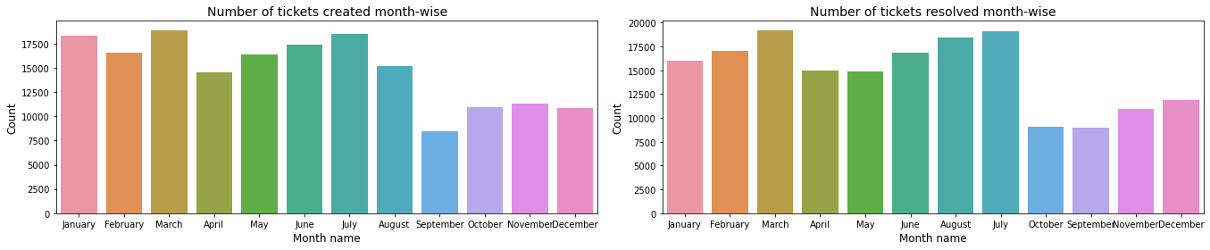
‘Assigned month’ and ‘Resolved month’ attributes
More number of tickets are created and resolved in March and the least in September.

Slide 10
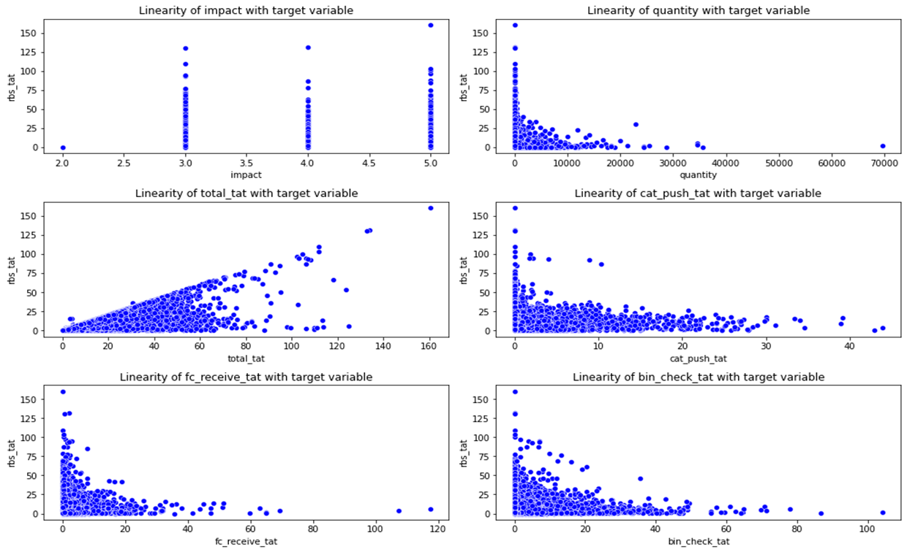
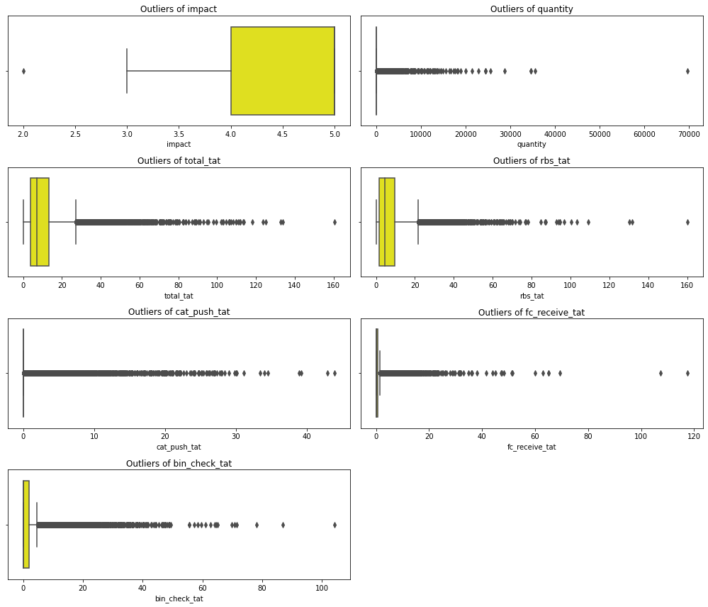
Linearity of numerical variables with target variable
Analysis of Continuous (Numerical) Variables
Outliers are present in almost all the numerical columns.

Slide 11
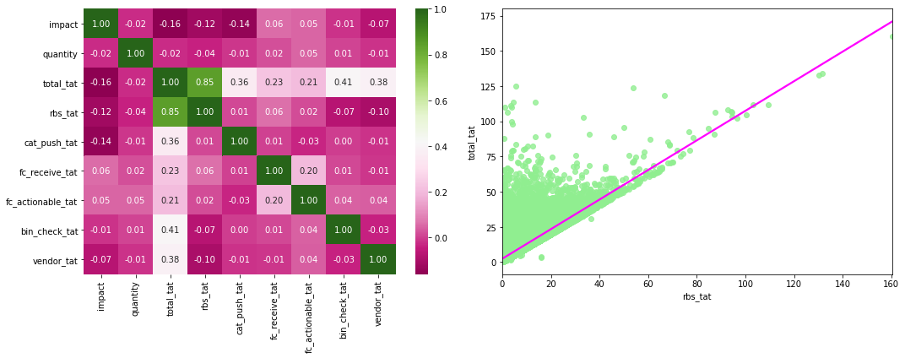
Bivariate Analysis
There is no multicollinearity among the variables.
There is high positive correlation between 'rbs_tat' and 'total_tat'.

Slide 12
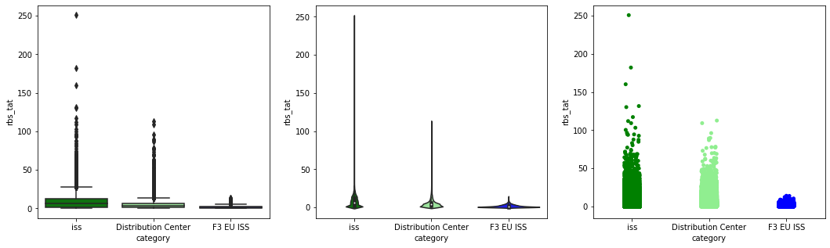
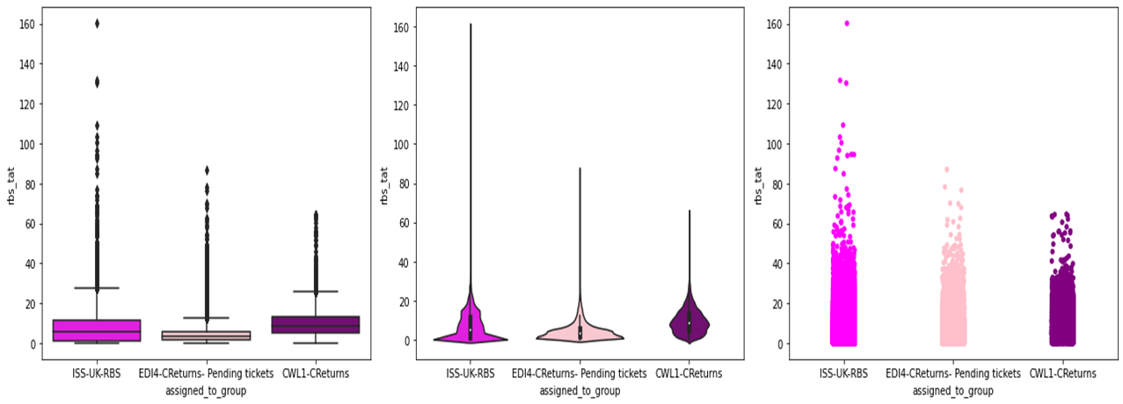
Analysis of 'category' with 'rbs_tat‘
Most of the outliers are present under 'iss' category.
The distribution of 'rbs_tat' taken by the 'iss' category is highly skewed.
Analysis of 'assigned_to_group' with 'rbs_tat‘
Most of the outliers are present in 'ISS-UK-RBS' class.
The distribution of 'rbs_tat' taken by the 'ISS-UK-RBS' team is more when compared to other teams.

Slide 13
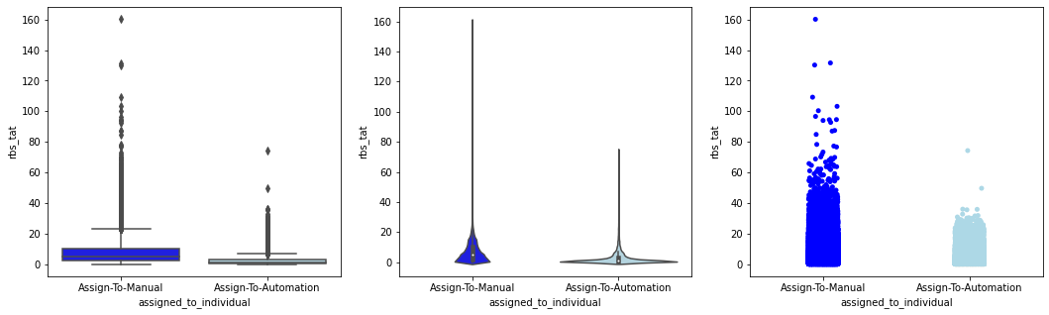
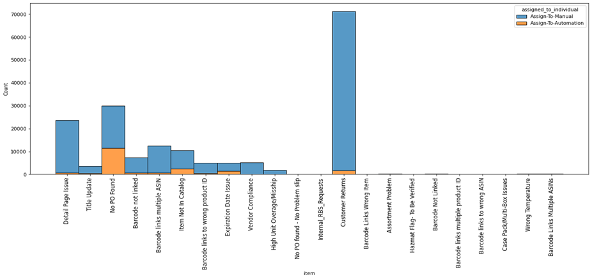
Analysis of 'assigned_to_individual' with 'rbs_tat‘
Most of the outliers are present in 'Assign-To-Manual' class.
The distribution is high under Manual ticket assignments.
Analysis of 'assigned_to_individual' with ‘item‘
Using Automation 20,068 tickets are being resolved. The top 'item' contributor is 'No PO found'.
Using Manual methods, 1,58,385 tickets are being resolved. The top 'item' contributor is 'Customer Returns'.

Slide 14
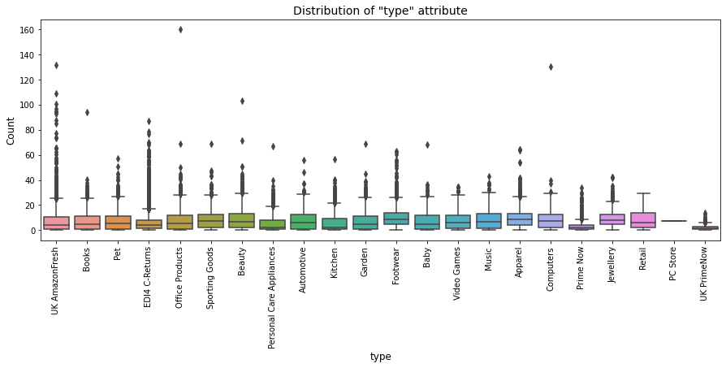
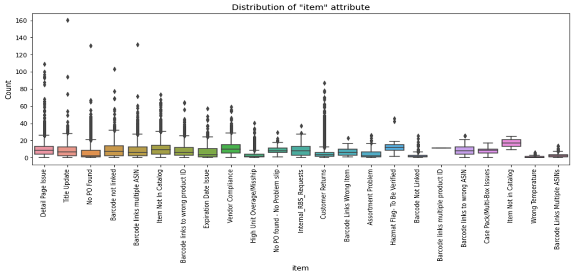
Analysis of 'type' with 'rbs_tat'
Most of the outliers are present in 'EDI4 C-Returns' class.
Analysis of 'item' with 'rbs_tat‘
Most of the outliers are present in 'Customer Returns' class under 'Item' attribute. The extreme outlier is present in 'Title Update‘.

Slide 15
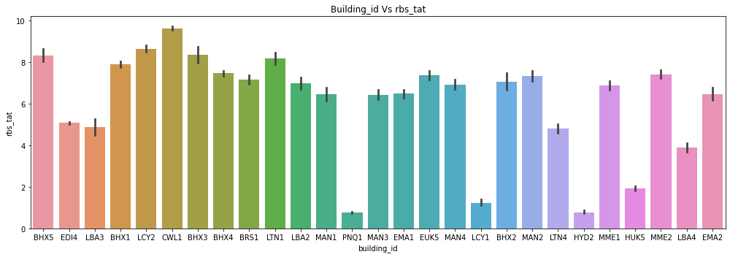
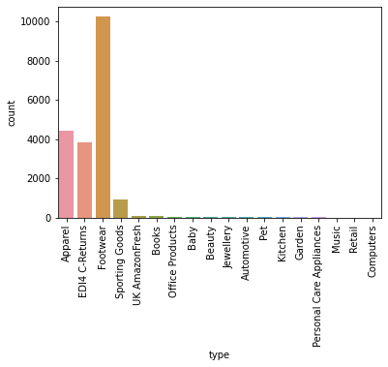
Building_id' with respect to ‘rbs_tat‘
CWL1 with Type
CWL1 has very high rbs_tat when compared to rest of the warehouses.
From this we can infer that, the team takes more time in resolving customer returns of apparel and footwear.

Slide 16
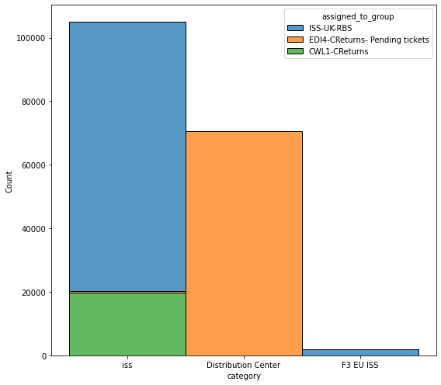
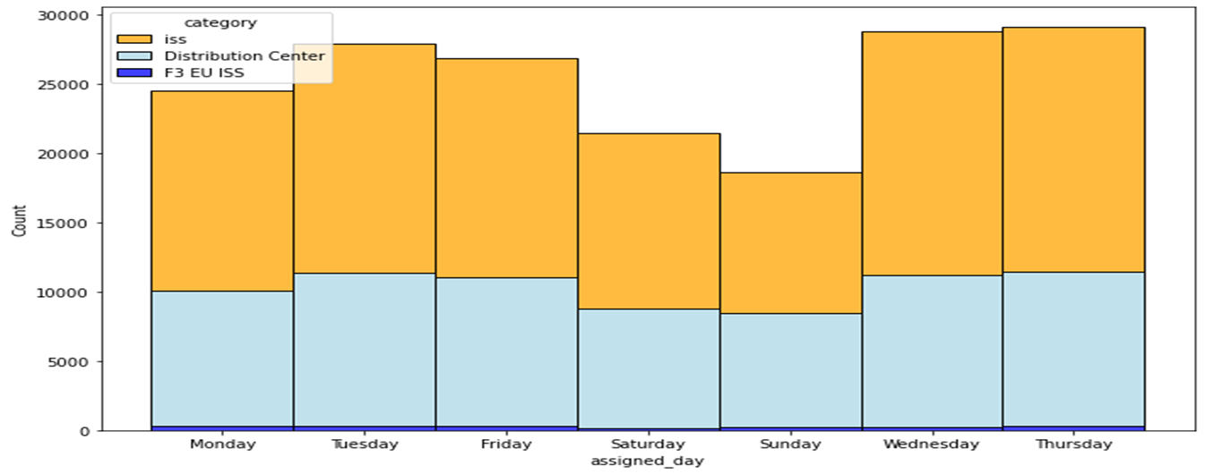
Analysis of ‘category’ with ‘assigned_to_group’
'CWL1-CReturns','EDI4-CReturns- Pending tickets', ‘ISS-UK-RBS' are the names of the teams which are assigned under 'iss' category.
'ISS-UK-RBS' team is assigned with more tickets under 'iss' category.
'EDI4-CReturns- Pending tickets' is the name of the team under 'Distribution Center' category. 'ISS-UK-RBS' team is also assigned under 'F3 EU ISS' category.
Analysis of ‘assigned day’ with respect to ‘category’
More tickets are assigned during mid weeks (i.e. Thursday and Wednesday). Also, major number of the tickets are assigned to 'iss' category on all the days.

Slide 17
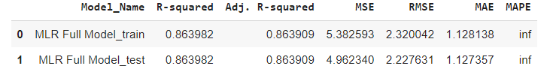
Model Building
Target variable is numerical and is not normally distributed.
Durbin Watson test : 2 (= 2.004) no autocorrelation.
Multicollinearity test: 'Cond. No' (= 1.41e+16) severe multicollinearity is present.
Linear relationship between dependant and independent variable: None of the plots show a specific pattern.
Breuschpagan test: Heteroskedasticity present in the data.
Jarque bera test: The residuals are not normally distributed
Overall F-Test & p-value of the Model: Prob (F-statistic): 0.00, i.e. the model is significant.

Slide 18
Thank You

